Slide 1

Credit Card Default Predictor
Group 6: Dhwani Teli, Nishant Chaudhari, Vyshnavi Siddula
Notes:
Hello everyone, our project is on credit card default prediction.
Defaulting is a key challenge for financial institutions because it directly affects profitability and customer trust.

Slide 2

Project Description
Credit card defaults can lead to significant financial losses, affecting profitability and customer trust.
This project aims to analyze and predict the likelihood of credit card default. The goal is:
To identify key factors that influence default probability.
To develop a predictive model that assists in distinguishing high-risk clients from reliable borrowers.
To provide actionable insights that strengthen financial risk management strategies.
Notes:
The objective of this project is to understand and predict which customers are likely to default next month.
to identify important factors influencing default, build predictive models, and provide insights that support proactive risk management.
Ultimately, the goal is to help banks reduce financial losses by identifying high-risk customers early.

Slide 3
Business Questions
Which customers are most likely to default on their credit card payments next month?
Does adding additional variables to the model significantly improve the accuracy of default prediction?
What customer characteristics and behaviors are the strongest indicators of future default?
Which customer segments represent the highest default risk (for example, low credit limit, high delinquency, or consistently low payments)?
How should the bank prioritize customers for intervention based on their predicted probability of default?
Notes:
We structured the project around the following key business questions : who is likely to default, whether additional variables improve accuracy, which customer behaviors matter the most, and how to prioritize interventions.
These business questions guided our modeling choices and evaluation metrics throughout the project.

Slide 4
Preprocessing of Data
 | Random Sampling | Handling Missing Data
Methodology | Function RAND() was used to ensure unbiased selection | Pivot table and filtering functionality was used to detect blank or missing entries
Results | A random sample of 10,000 records was extracted from the original dataset of 30,000 rows to create a manageable subset for analysis | The analysis revealed no missing values in the dataset.
The dataset contains outliers due to natural financial variability. We did not remove them because they represent real customer behavior and are important for predicting default risk.
Notes:
We performed essential cleaning, random sampling to obtain 10K records subset from the original dataset of 30K customers and ensured the dataset was ready for model building.
We observed natural financial variability such as large bill amounts, repayment delays, and wide credit limit ranges.
These variations are not “errors” but meaningful patterns—so instead of removing outliers, we retained them because they represent real customer behavior critical for prediction.

Slide 5
Logistic Regression

Slide 6
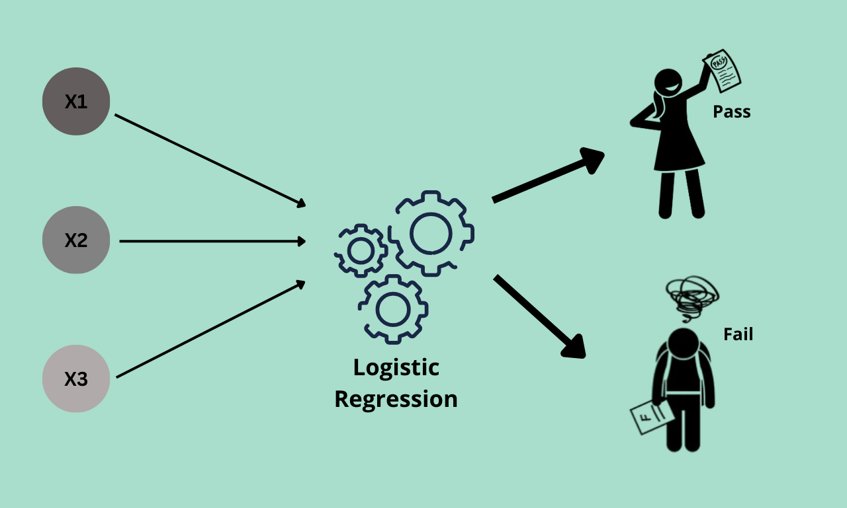
Rationale for using Logistic Regression
It provides a clear, interpretable baseline for comparison of further complex models.
To identify how each predictor affects the probability of default.
It supports systematic feature selection to keep only meaningful predictors.
Notes:
We chose logistic regression as our first model because it provides a strong, interpretable baseline.
It helps us understand how each variable impacts the probability of default, which is crucial in regulated industries like banking.
It also supports stepwise feature selection, allowing us to refine the model by keeping only significant predictors.

Slide 7
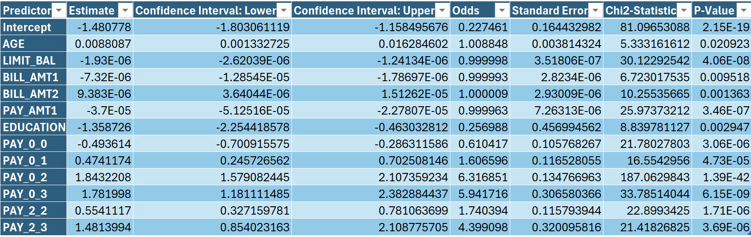
Model Equations (Post Feature Selection- Stepwise)
Logit (Default = 1) = -1.481 + 0.009*AGE + 0*LIMIT_BAL + 0*BILL_AMT1 + 0*BILL_AMT2 + 0*PAY_AMT1 - 1.359*EDUCATION - 0.494*PAY_0_0 + 0.474*PAY_0_1 + 1.843*PAY_0_2 + 1.782*PAY_0_3 + 0.554*PAY_2_2 + 1.481*PAY_2_3
Odds (Default = 1) = e (-1.481 + 0.009*AGE + 0*LIMIT_BAL + 0*BILL_AMT1 + 0*BILL_AMT2 + 0*PAY_AMT1 - 1.359*EDUCATION - 0.494*PAY_0_0 + 0.474*PAY_0_1 + 1.843*PAY_0_2 + 1.782*PAY_0_3 + 0.554*PAY_2_2 + 1.481*PAY_2_3)
P (Default = 1) = 1
1 + e-(-1.481 + 0.009*AGE + 0*LIMIT_BAL + 0*BILL_AMT1 + 0*BILL_AMT2 + 0*PAY_AMT1 - 1.359*EDUCATION - 0.494*PAY_0_0 + 0.474*PAY_0_1 + 1.843*PAY_0_2 + 1.782*PAY_0_3 + 0.554*PAY_2_2 + 1.481*PAY_2_3)
Notes:
This slide shows the equation produced from stepwise selection.
Variables like repayment status (PAY_0, PAY_2) have the strongest contributions, confirming that recent payment behavior is the best predictor of default.
We can calculate logit, odds, and predicted probability for any new customer record using this equation.

Slide 8
Cut Off Selection
Model | Description | Training AUC | Validation AUC | Validation Accuracy | Validation Precision | Validation Sensitivity | Validation F1 Score
Model 1 | Cut off 0.5 | 0.7601 | 0.7724 | 82.296 % | 71.882 % | 33.145 % | 0.4537
Model 2 | Cut off 0.18 | 0.7601 | 0.7724 | 74.968 % | 45.327 % | 62.344 % | 0.5249
Model 3 | Cut off 0.26 | 0.7601 | 0.7724 | 80.695 % | 57.196 % | 51.521 % | 0.5421
Model 3 (cutoff = 0.26) is selected as the final model because it delivers the best balance between precision and sensitivity, resulting in the highest F1 score (0.5421).
Notes:
We tested multiple cutoff values and selected 0.26 because it strikes the best balance between precision and sensitivity.
This cutoff maximizes the F1 score, meaning it produces the most balanced performance when dealing with imbalanced data like default vs. non-default.

Slide 9
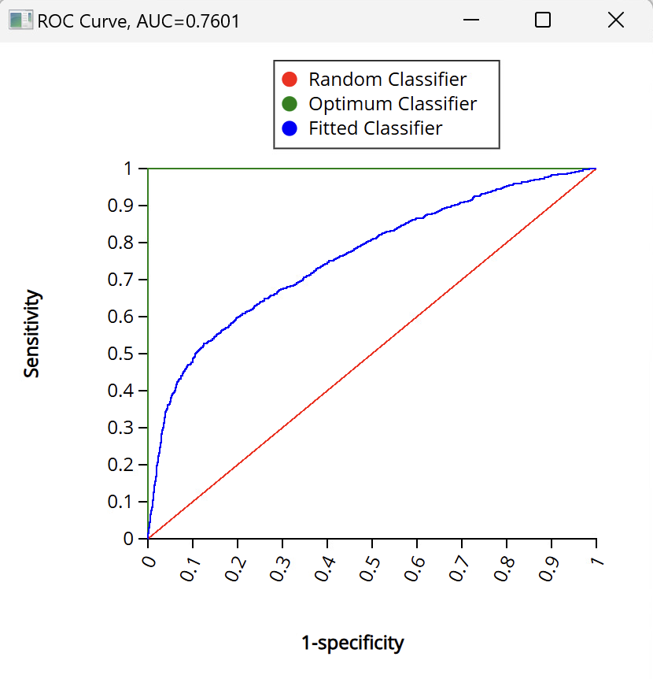
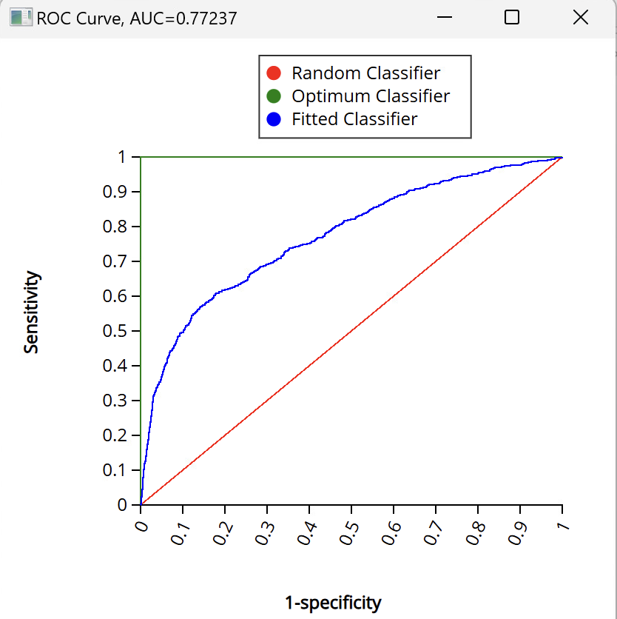
Model Performance (Cut Off: 0.26)
Training Data
Validation Data
Metric | Value
Accuracy (#correct) | 4847
Accuracy (%correct) | 80.79679947
Specificity | 0.889642025
Sensitivity (Recall) | 0.506259781
Precision | 0.553938356
F1 score | 0.529026983
Success Class | 1
Success Probability | 0.26
Metric | Value
Accuracy (#correct) | 3227
Accuracy (%correct) | 80.69517379
Specificity | 0.890102828
Sensitivity (Recall) | 0.515219842
Precision | 0.571964956
F1 score | 0.542111507
Success Class | 1
Success Probability | 0.26
Training data: ROC Curve Data, AUC=0.7601
Validation data: ROC Curve Data, AUC=0.77237
With training AUC = 0.7601 and validation AUC = 0.7724, the model demonstrates strong and consistent discriminatory power without evidence of overfitting.
Notes:
Our logistic regression achieved a training AUC of 0.7601 and validation AUC of 0.7724.
These values are very close, which indicates the model generalizes well and is not overfitting.
Both curves show strong discriminatory power between defaulters and non-defaulters.

Slide 10

Hypothetical New Customer Record
Variable | Value
LIMIT_BAL | 80,000
EDUCATION | 2 (University)
AGE | 34
PAY_0 | 1 (1 month delay)
PAY_2 | 2 (2 months delay)
BILL_AMT1 | 25,000
BILL_AMT2 | 22,000
PAY_AMT1 | 2,500
Using the logistic regression equations:
Logit: - 0.377 | Odds: 0.686 | Predicted probability of default: 0.665 (66.5%)
This probability reflects: Payment delays, Moderate credit limit, High recent bill amounts relative to payments. We classify the customer as:
Likely to Default (Predicted Class 1): This customer falls into the high-risk segment (probability more than 0.26) and should be prioritized for intervention.
Notes:
We applied our logistic regression model to a new hypothetical customer.
The model produced a predicted probability of about 66.5%. This probability reflects: Payment delays, Moderate credit limit, High recent bill amounts relative to payments.
Hence, we classify this customer as high-risk and likely to default, meaning the bank should take preventive action.

Slide 11
Classification Tree

Slide 12
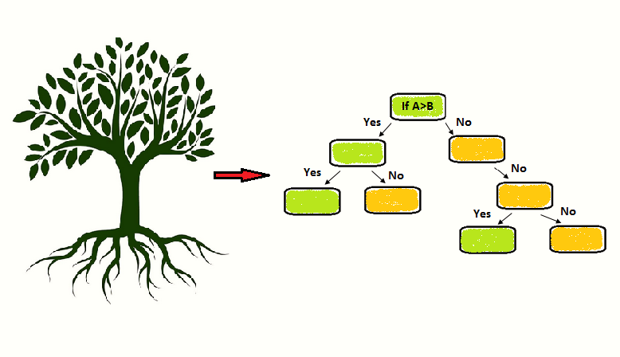
Rationale for using Classification Tree
As the target variable is binary.
Trees naturally handle both categorical and numeric variables.
The output consists of simple, interpretable decision rules, which are ideal for credit risk default predictors.
Notes:
For the next part, I will walk through the Classification Tree model.
We used a tree because it is simple, transparent, and easy to explain to business stakeholders.
It handles both numeric and categorical variables and helps us see clear decision rules.
This model helps us understand which customer behaviors most strongly indicate default risk.

Slide 13
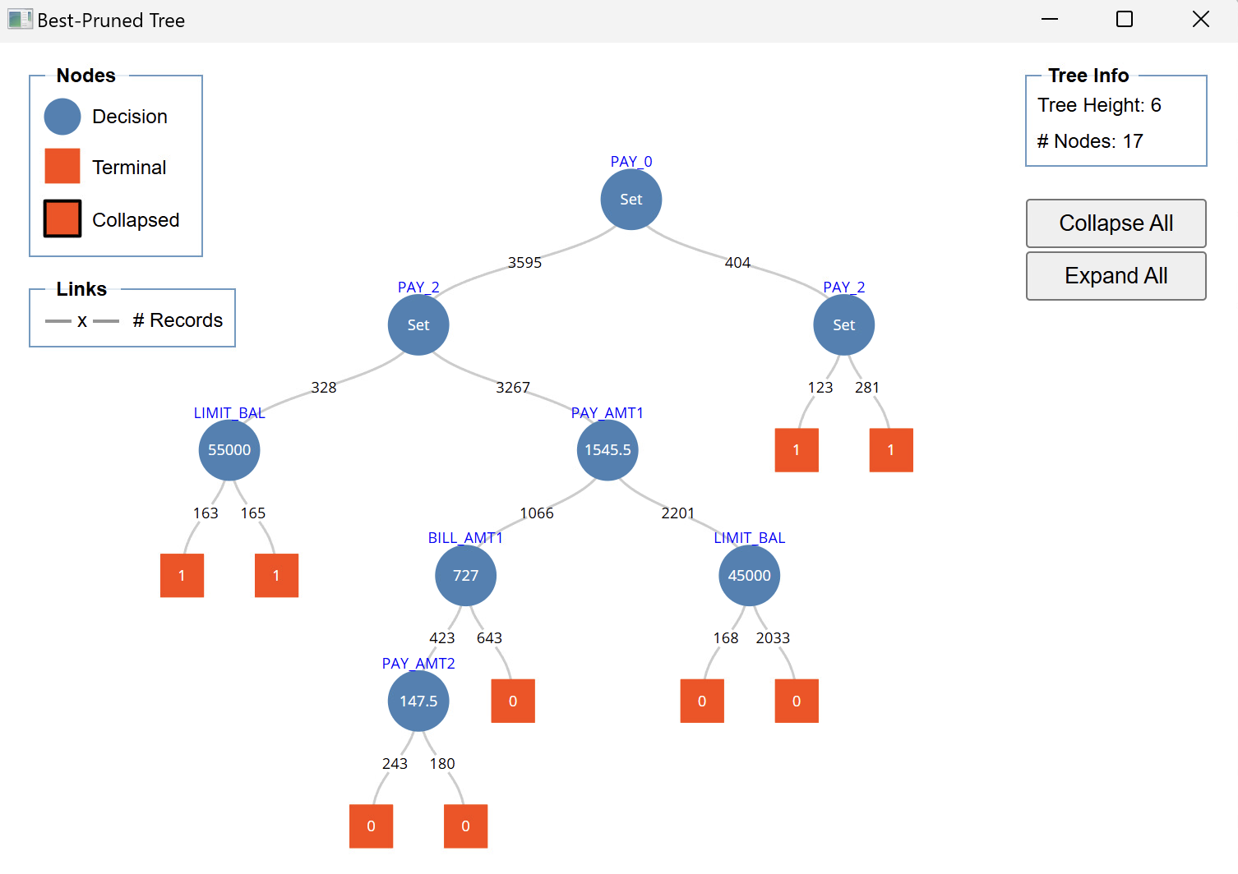
Selection of Best Performing Classification Tree
Tree was trained under four configurations by varying minimum # records in terminal nodes: not specified, 600, 400, and 200.
Across the first three configurations, the real signal was lost when pruning resulting in a one-split overly simplified tree.
The 200-record configuration retained a substantially larger and more informative best-pruned tree (17 nodes), maintaining meaningful splits.
While accuracy, precision, and specificity remained nearly identical, the one-split pruned trees achieved an AUC of 0.65 and the best-pruned model from the 200-record configuration achieved a significantly stronger AUC of 0.76.
Best Pruned Tree
Based on these results, the best-pruned tree derived from the 200-record terminal node setting was selected as the final model. This configuration avoided both extremes—overfitting from overly complex full-grown trees and underfitting from aggressively pruned single-split models—making it the most reliable and interpretable decision tree for predicting credit card default.
Notes:
We experimented with different tree configurations by changing the minimum records in each terminal node.
When the minimum was too high, the tree collapsed into a single rule and lost important patterns.
With smaller node sizes, the model was able to capture more meaningful repayment behavior.
This gave us a clearer view of how customers move through the risk segments.
This is the final pruned tree that performed the best.
The first split is on PAY_0, which is last month’s payment status. This is the strongest indicator of risk.
PAY_2, payment amounts, bill amounts, and credit limit appear deeper in the tree and help refine the customer segments.
Overall, the tree shows that recent delinquency and low payments are the primary drivers of default.

Slide 14
Cut Off Selection
Model | Description | Training AUC | Validation AUC | Validation Accuracy | Validation Precision | Validation Sensitivity | Validation F1 Score
Model 1 | Cut off 0.5 | 0.7612 | 0.7598 | 82.621 % | 73.762 % | 33.596 % | 0.4617
Model 2 | Cut off 0.3 | 0.7612 | 0.7598 | 81.570 % | 60.246 % | 49.718 % | 0.5248
Model 3 | Cut off 0.2 | 0.7612 | 0.7598 | 74.044 % | 44.293 % | 66.065 % | 0.5303
Model 2 (cutoff = 0.3) is selected as the final model because it delivers the best balance between precision and sensitivity, resulting in the highest F1 score (0.5448).
Notes:
After generating default probabilities, we tested different cutoff values.
A cutoff of 0.30 gave the best balance between catching actual defaulters and keeping false positives manageable.
This cutoff is the most useful for the bank because it helps detect risky customers earlier.
It supports better intervention and reduces the chance of missing high-risk accounts.

Slide 15
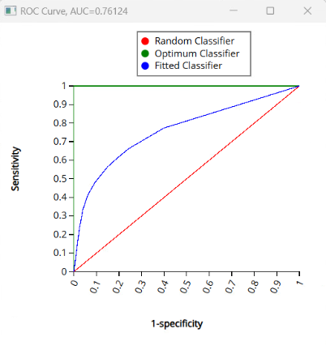
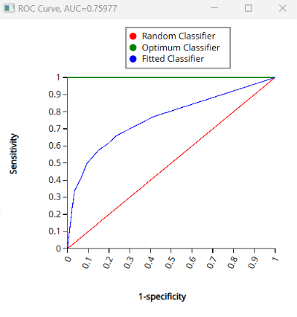
Model Performance (Cut Off: 0.3)
Training Data
Validation Data
Metric | Value
Accuracy (#correct) | 4896
Accuracy (%correct) | 81.61360227
Specificity | 0.907434865
Sensitivity (Recall) | 0.478873239
Precision | 0.583412774
F1 score | 0.525999141
Success Class | 1
Success Probability | 0.3
Metric | Value
Accuracy (#correct) | 3262
Accuracy (%correct) | 81.5703926
Specificity | 0.906491003
Sensitivity (Recall) | 0.497181511
Precision | 0.602459016
F1 score | 0.524780729
Success Class | 1
Success Probability | 0.3
Training data: ROC Curve Data, AUC=0.7612
Validation data: ROC Curve Data, AUC=0.7598
With training AUC = 0.7612 and validation AUC = 0.7598, the model demonstrates strong and consistent discriminatory power without evidence of overfitting.
Notes:
The tree shows stable performance with training and validation AUC values around 0.76.
The lift chart we got showed that the top predicted decile has more than three times the average default rate.
This means the tree ranks customers effectively and can clearly separate high and low risk.
Even though logistic regression is slightly stronger numerically, the tree adds value because of its interpretability.

Slide 16
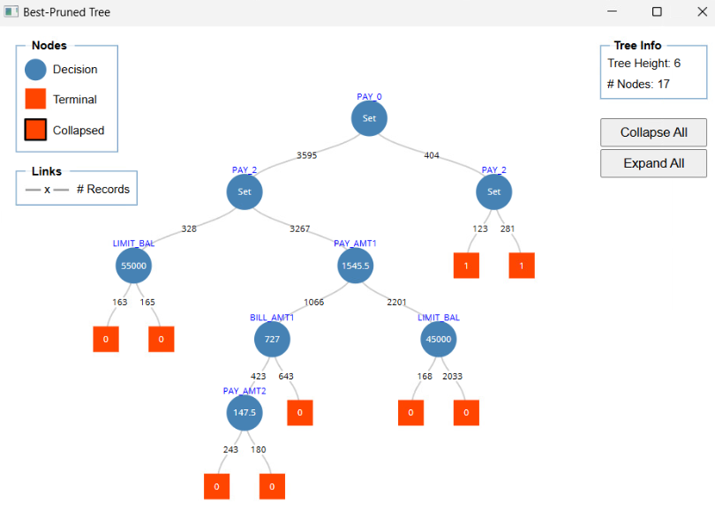
Hypothetical New Customer Record
Variable | Value
LIMIT_BAL | 120,000
PAY_0 | -2 (no consumption)
PAY_2 | 1 (1 month delay)
BILL_AMT1 | 60,000
PAY_AMT1 | 5,000
PAY_AMT2 | 4,000
For this hypothetical example,
PAY_0 < 0, hence left branch -> PAY_2 > 0, hence right branch -> PAY_AMT1 > 1545.5, hence right branch -> LIMIT_BAL > 45000, hence right branch -> the customer will not default the credit card.
Notes:
Here is how a new customer flows through the model.
First, we check PAY_0, then PAY_2, then repayment amounts.
Based on this path, we classify the customer as either likely or unlikely to default.
This example shows how easy it is to explain decisions generated by the tree.

Slide 17
Neural Network

Slide 18
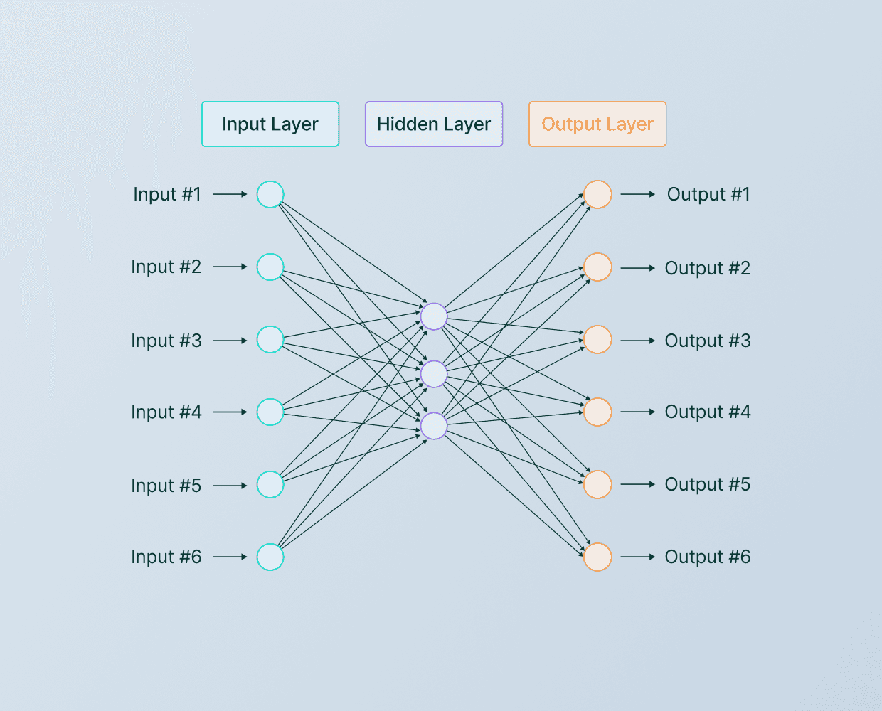
Rationale for using Neural Network
Ability to Capture Complex Non-Linear Patterns
Works Well with Large and High-Dimensional Data
Provides an Additional Benchmark Against Simpler Models

Slide 19
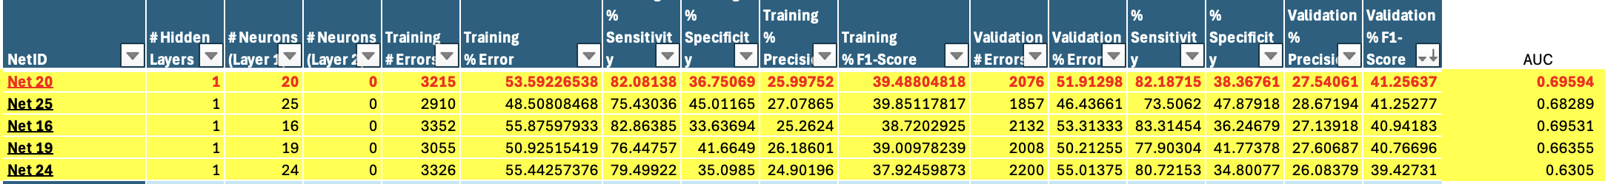
Selection of Best Performing Neural Network
For all five network structures the AUC values are between 0.63 and 0.70, which means every model performs better than random guessing (AUC = 0.50). The best networks are Net 20 (AUC ≈ 0.696) and Net 16 (AUC ≈ 0.695).
Because Net 20 has the highest AUC and also competitive validation F1-score, we treat Net 20 as the preferred network architecture for further analysis and cutoff selection.

Slide 20
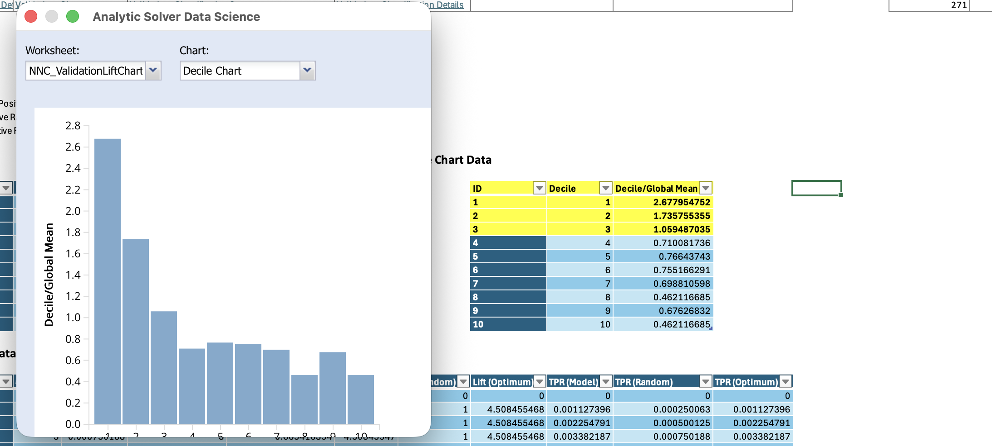
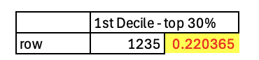
Selection of Top Decile & New Cutoff Neural Network

Slide 21
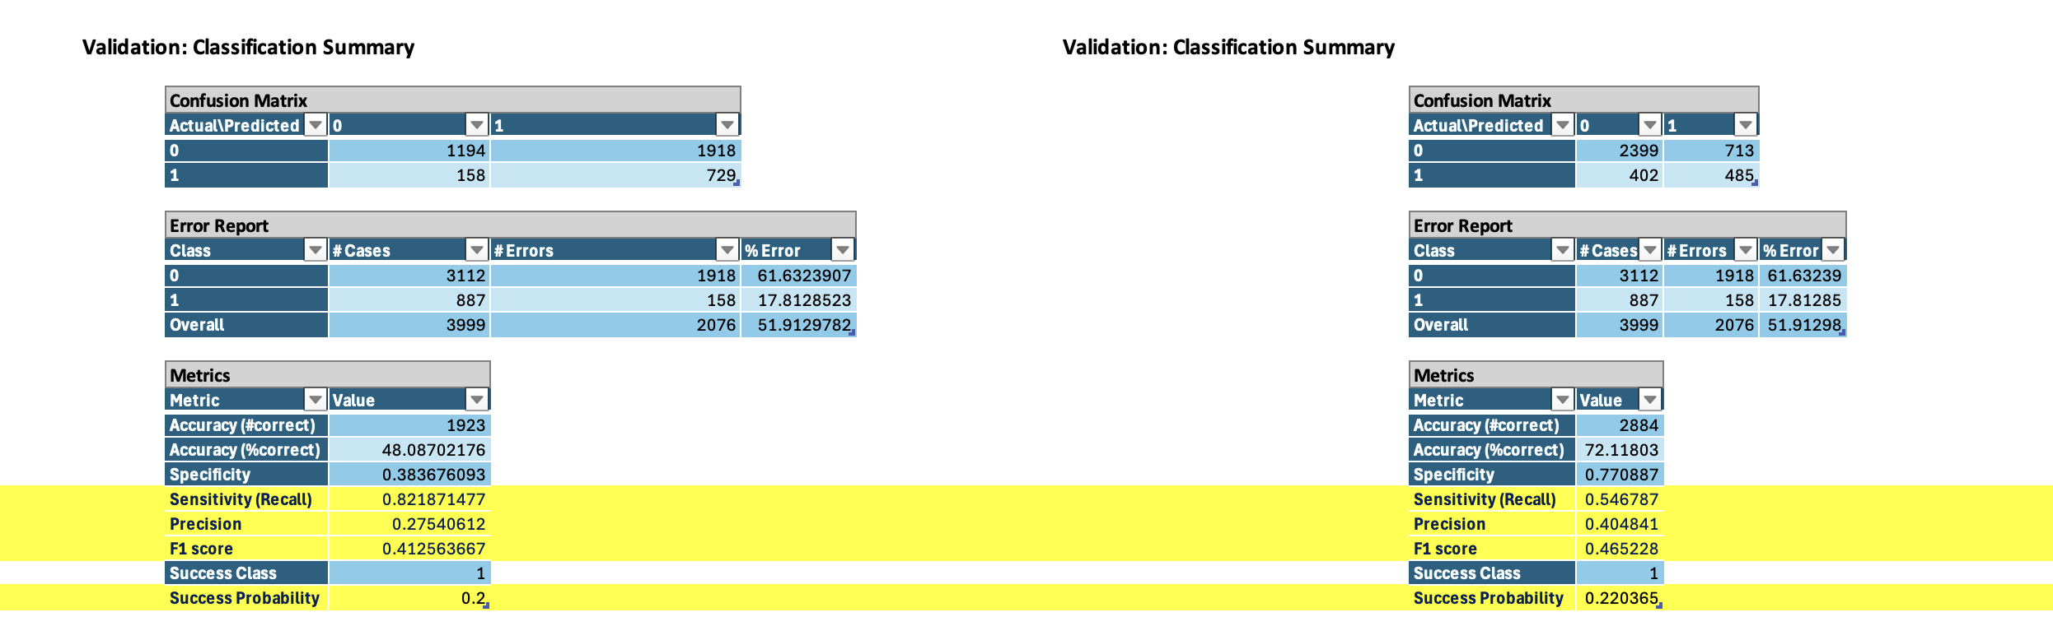
Selection of Top Decile & New Cutoff Neural Network

Slide 22
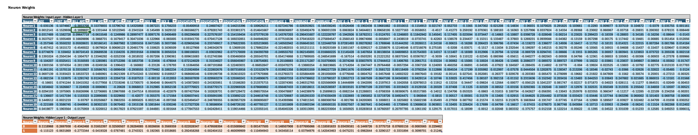
Resulting Neural Network
This resulting neural network uses a fully connected architecture with all standardized input variables feeding into 20 hidden neurons, which then connect to two output nodes (default vs. non-default).
The learned weights and biases capture complex nonlinear interactions between credit limit, payment delays, bill amounts, demographics, and other factors to produce a churn/default probability for each customer.
Overall, this model is more flexible than logistic regression and can better capture subtle patterns in the data, while still outputting a single interpretable risk score.

Slide 23
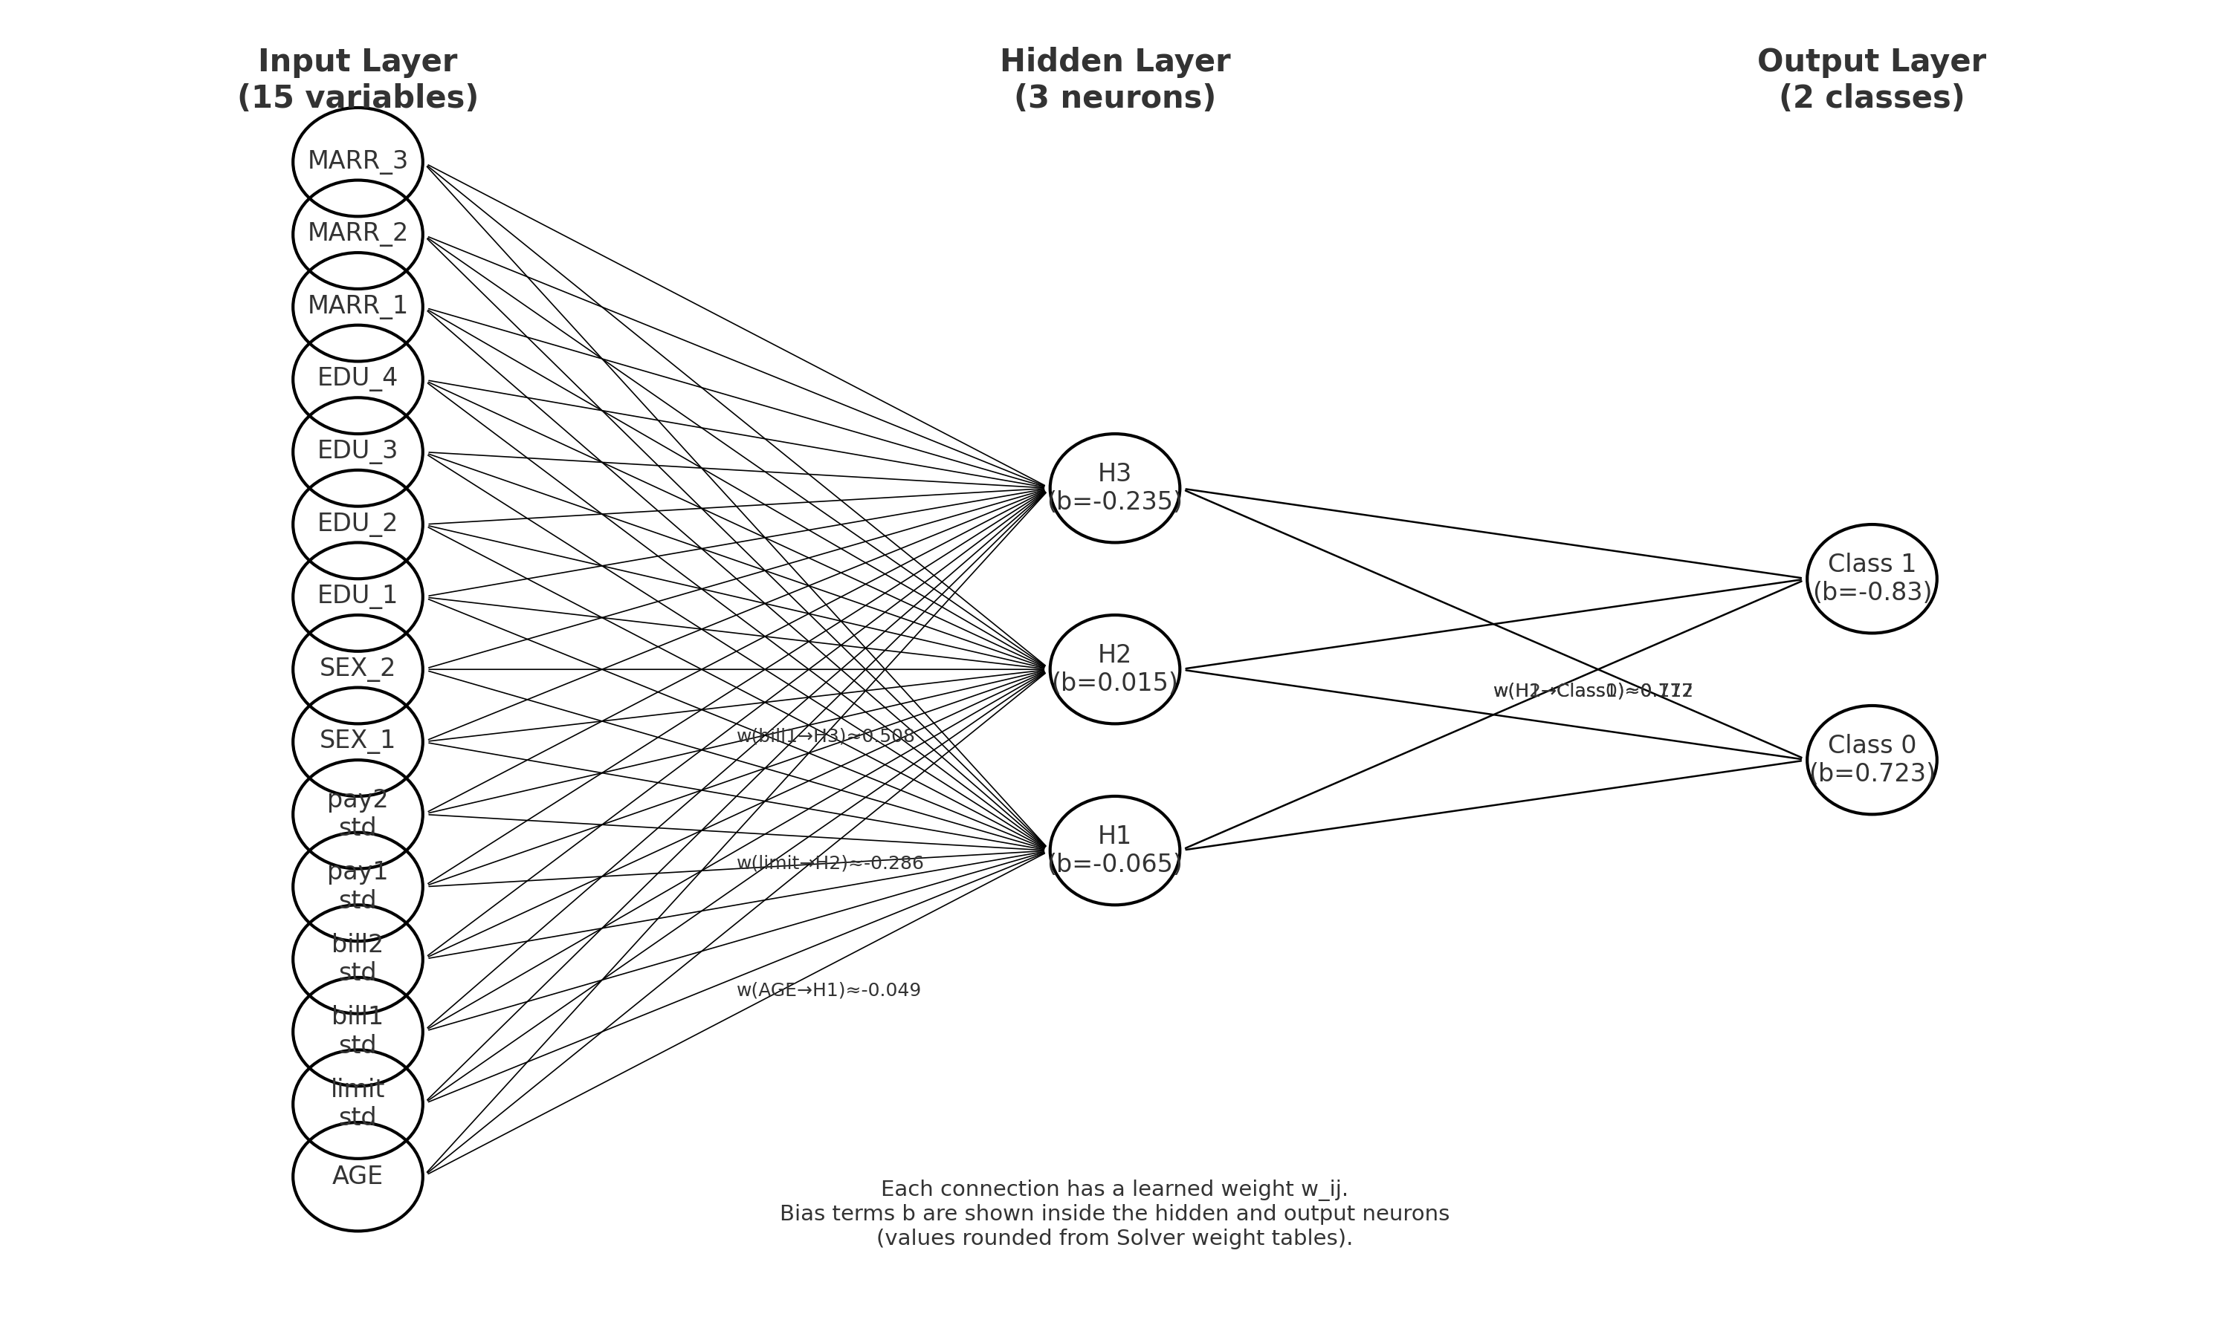
Neural Network

Slide 24
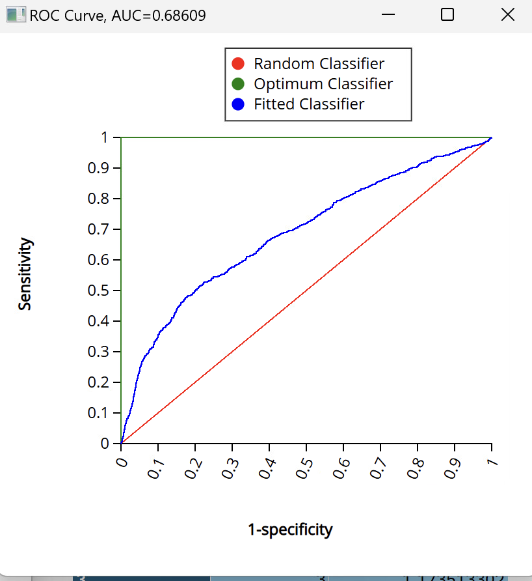
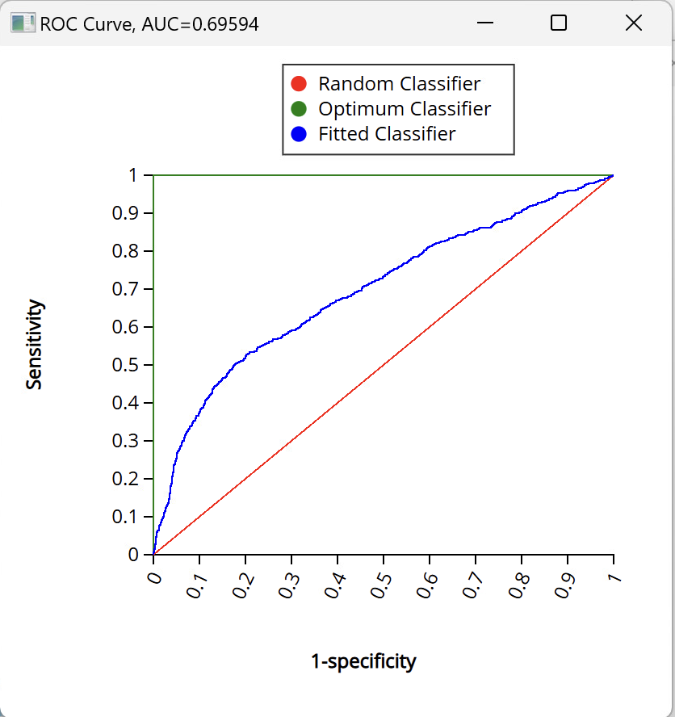
Model Performance (Cut Off: 0.22)
Training Data
Validation Data
Metric | Value
Accuracy (#correct) | 4310
Accuracy (%correct) | 71.84530755
Specificity | 0.769963991
Sensitivity (Recall) | 0.528169014
Precision | 0.38330494
F1 score | 0.444225074
Success Class | 1
Success Probability | 0.22036505
Metric | Value
Accuracy (#correct) | 2884
Accuracy (%correct) | 72.11802951
Specificity | 0.770886889
Sensitivity (Recall) | 0.546786922
Precision | 0.404841402
F1 score | 0.465227818
Success Class | 1
Success Probability | 0.22036505
Training data: ROC Curve Data, AUC=0.6861
Validation data: ROC Curve Data, AUC=0.6959
With training AUC = 0.6861 and validation AUC = 0.6959, the model demonstrates strong and consistent discriminatory power without evidence of overfitting.

Slide 25
Hypothetical New Customer Record
Variable | Value
LIMIT_BAL | 80,000
EDUCATION | 2 (University)
AGE | 34
PAY_0 | 1 (1 month delay)
PAY_2 | 2 (2 months delay)
BILL_AMT1 | 25,000
BILL_AMT2 | 22,000
PAY_AMT1 | 2,500
Using the logistic regression equations:
Logit: - 0.846 | Odds: 2.3 | Predicted probability of default: 0.70 (70%)
This probability reflects: Payment delays, Moderate credit limit, High recent bill amounts relative to payments. We classify the customer as:
Likely to Default (Predicted Class 1): So the models classify this customer as Class 1: likely to default / high-risk, and they should be prioritized for intervention.

Slide 26
Comparing the Models

Slide 27
Metric Comparison
Model | AUC | Precision | Sensitivity | F1
Logistic Regression | 0.772 | 58% | 62% | 0.542
Classification Tree | 0.760 | 60% | 50% | 0.525
Neural Network | 0.696 | 41% | 55% | 0.465

Slide 28
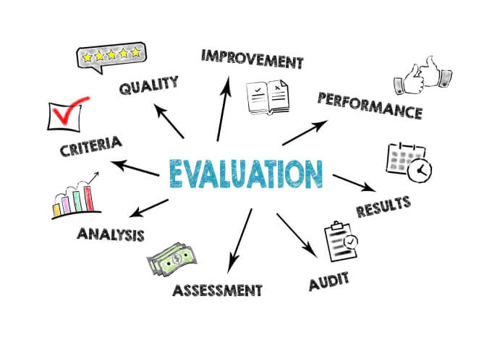
Rationale
Logistic Regression is the preferred model because it delivers the best predictive accuracy, strongest class-balance performance, and is easily interpretable for financial decision-making and regulatory compliance.
Logistic Regression performed the best overall, achieving the highest AUC (0.772) and F1 Score (0.542)
Classification Tree provided comparable performance, with slightly lower AUC but higher precision (60%). Good for interpretability and business explainability.
Neural Network underperformed on this dataset, likely due to limited data size, noise, lack of non-linearity, and sensitivity to hyperparameters.
For credit-risk problems where interpretability + stability matter, Logistic Regression is the most reliable model.

Slide 29
Summary

Slide 30
Addressing Business Questions
1. Which customers are most likely to default next month?
Using the optimized cutoff of 0.26, customers whose predicted probability is ≥ 0.26 are flagged as high-risk. It allows the bank to reliably identify a meaningful portion of customers who are likely to default, while avoiding too many false alarms.
2. Does adding additional variables significantly improve prediction accuracy?
Models with and without feature selection showed nearly identical AUC (0.7744 vs. 0.7724) and almost the same accuracy (82.39% vs. 82.30%) which indicates feature selection did not materially improve performance. Adding or removing a small number of predictors does not significantly impact predictive accuracy but does help simplify the model.
3. What customer characteristics and behaviors are the strongest indicators of default?
The strongest indicators of default are the customer’s recent repayment behavior, especially the repayment status variables PAY_0 and PAY_2.
4. Which segments of customers represent the highest risk?
Probability ≥ 0.26, High late-payment statuses (PAY_0 ≥ 1), Consistently low repayment amounts, High bill amounts relative to credit limit, Lower-limit customers with rising balances
5. How should the bank prioritize customers for intervention?
Probability Segment | Action
≥ 0.26 (High Risk) | Immediate outreach, limit freeze/review, financial counseling
0.18 – 0.26 (Medium Risk) | Monitor behavior, send reminders, offer payment plans
< 0.18 (Low Risk) | Routine servicing, no intervention needed
Notes:
The first business question is who is most likely to default, are the once who has cut off more than 0.26.
Adding more variables did not significantly improve accuracy, because with and without feature selection AUC was almost similar.
PAY_0 and PAY_2 consistently lead the model and explain most of the risk.
Probability ≥ 0.26, High late-payment statuses ,Consistently low repayment amounts, High bill amounts relative to credit limit, Lower-limit customers with rising balances represent the highest risk groups. These customers appear in the top deciles and should be flagged for early outreach..
For high risk segments, the banks should Immediately reach to the customers, limit freeze/review, or provide financial counseling
For medium risk segment, banks should Monitor behavior, send reminders, offer payment plans
And for low risk no intervention is needed – routine servicing should be fine

Slide 31
Recommendations
Proactively Reach Out to High-Risk Customers:
Customers with a risk score above 0.26 should be contacted early.
Monitor Medium-Risk Customers Closely: Medium-risk customers (scores between 0.18 and 0.26) may not yet be in serious trouble, but they show warning signs.
Maintain Standard Servicing for Low-Risk Customers: Low-risk customers (below 0.18) do not require additional action.
Use the Model for Better Credit Management: Adjusting credit limits- Updating collections strategies- Allocating customer service resources- Designing targeted financial wellness programs
The findings allow the organization to identify risk earlier, reach customers sooner, and reduce financial losses. By focusing on repayment behavior and using a balanced risk threshold, the business can make smarter, more proactive decisions that protect both the company and its customers.
Notes:
The highest risk segments include customers with repeated late payments, high utilization, and low payments.
These customers should be monitored closely because they represent the highest likelihood of default.

Slide 32
Project Learnings
Developed hands-on understanding of model building under data imbalance
Learned that repayment behavior variables consistently outperform demographic variables in predicting default.
Understood the importance of AUC, sensitivity, precision, and F1 score for comparing best working model.
Gained experience in cutoff tuning to balance false positives and false negatives for business decisions.
Realized the value of simple models for interpretability (logistic / tree) and complex models for stronger predictive power (neural networks).
Understood limitations such as potential data-quality issues - negative bill amounts, extreme values, and the restricted set of available variables.
Learned how to translate technical outputs into business-focused insights for early intervention, credit reviews, and risk segmentation.
Notes:
Gained practical experience handling data imbalance and understanding how it impacts model performance and stability.
Learned that repayment behavior variables like PAY_0 and PAY_2 are the strongest predictors compared to demographic variables.
Understood how AUC, sensitivity, precision, and F1 score help compare models and choose the most reliable one.
Identified limitations such as negative bill amounts, extreme payment values, and the restricted range of available predictors.
Strengthened ability to tune cutoffs, balance errors, and convert model outputs into actionable insights for risk segmentation and early customer intervention.

Slide 33
Thank You

Slide 34
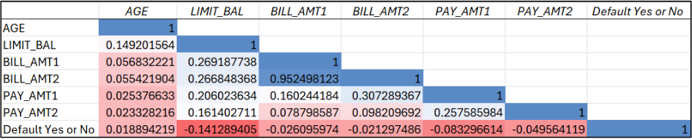
Correlation Table
Weak linear correlations between the independent variables and the target variable (Default Yes or No)
Customers with greater credit limits (LIMIT_BAL) are marginally less likely to default, as it has a small negative correlation.
Weak negative correlations among payment-related variables indicate bigger payments are linked to a lower default risk.
Small correlation between target variable and age or bill amounts indicate no significant impact.

Slide 35
Variable Inclusion
Variables chosen because they are the main drivers of credit risk.
Included Variables:
Demographic Variables – Customer Profiling
Credit Limit – Financial Capacity
Repayment Status – Repayment Behavior
Recent Billing & Payment Amounts – Debt Trends
Excluded Variables:
ID- Redundant

Slide 36
Coefficients Interpretation
Numerical Variables
Age: As the age of the customer increases by 1, the odds of the customer to default the credit card multiplies by 1.01 times holding the other variables constant.
Limit_Bal: When the limit balance of the customer increases by 1 NT dollar, the odds of the customer to default multiplies by 0.999 times holding other variables constant.
Bill_Amt1: When the bill amount of September 2005 increases by 1 NT dollar, the odds of the customer to default multiplies by 0.999 times holding other variables constant.
Bill_Amt2: When the bill amount of August 2005 increases by 1 NT dollar, the odds of the customer to default multiplies by 1.000 times holding other variables constant.
Pay_Amt1: When the amount of previous payment in September 2005 increases by 1 NT dollar, the odds of the customer to default multiplies by 0.999 times holding other variables constant.

Slide 37
Coefficients Interpretation (Contd.)
Categorial Variables
Education: When the education of the customer is unknown, the odds of him/her to default the credit card multiplies by 0.257 times than the customer who is in graduate school holding other variables constant.
Pay_0_0: The odds of a customer to default the credit card with repayment status as __ in September 2005 multiplies by 0.610 times the customer who has no consumption holding other variables constant.
Pay_0_1: The odds of a customer to default the credit card with repayment delay of 1 month as of September 2005 multiplies by 1.607 times the customer who has no consumption holding other variables constant.
Pay_0_2: The odds of a customer to default the credit card with repayment delay of 2 months as of September 2005 multiplies by 6.317 times the customer who has no consumption holding other variables constant.
Pay_0_3: The odds of a customer to default the credit card with repayment delay of 3 months as of September 2005 multiplies by 5.943 times the customer who has no consumption holding other variables constant.
Pay_2_2: The odds of a customer to default the credit card with repayment delay of 2 months as of August 2005 multiplies by 1.740 times the customer who has no consumption holding other variables constant.
Pay_2_3: The odds of a customer to default the credit card with repayment delay of 3 months as of August 2005 multiplies by 4.399 times the customer who has no consumption holding other variables constant.

Slide 38
Model Performance (Cut Off: 0.5)
Training Data
Validation Data
Metric | Value
Accuracy (#correct) | 4959
Accuracy (%correct) | 82.6637773
Specificity | 0.960177928
Sensitivity (Recall) | 0.333333333
Precision | 0.693811075
F1 score | 0.450317125
Success Class | 1
Success Probability | 0.5
Metric | Value
Accuracy (#correct) | 3304
Accuracy (%correct) | 82.62065516
Specificity | 0.965938303
Sensitivity (Recall) | 0.335963923
Precision | 0.737623762
F1 score | 0.46165763
Success Class | 1
Success Probability | 0.5
Training data: ROC Curve Data, AUC=0.7612
Validation data: ROC Curve Data, AUC=0.7598
With training AUC = 0.7612 and validation AUC = 0.7598, the model demonstrates strong and consistent discriminatory power without evidence of overfitting.

